Slide 1
Carers Session – Financial Assessments
What to expect from care charges and financial assessments
Zoe Graham – Financial Assessments & Benefits Advice Team Manager

Slide 2
Introduction
Welcome. We will talk through care charges and what happens in a financial assessment.
What a financial assessment is
Why it is done
What happens
What to have ready
Timescales and next steps
Choices and support
Please ask questions at any time.
Notes:
Welcome, and thank you for joining us. My name is Zoe Graham, worked on the FABA team for 5 years and I’m currently the manager covering maternity leaveI will explain what a financial assessment is, why it happens, what to expect, and where to get support. Please feel free to ask questions at any point.

Slide 3
What Is a Financial Assessment?
What it means
What is checked
A financial assessment checks if someone needs to pay towards their care and how much they may need to pay.
Income, such as pensions and benefits
Savings and capital
Some expenses
Capital above £23,250 means the person must pay the full cost of their care.
Notes:
It is a check to see whether a person needs to pay towards their care and, if so, how much. We look at things like income, savings, capital and some allowed expenses. Depending on the type of assessment (residential (care home) or non residential (care at home)), a Government set allowance will also be applied. The main point to remember is that if capital is above £23,250, the person will pay the full cost of their care until they fall below this threshold. Property – home the person lives in is not included within non residential care assessments but may be considered for residential assessments.

Slide 4
Why We Do Financial Assessments
National guidlines:
These assessments follow national law – Care Act 2014, not just local decisions.
Local policy:
Warwickshire's policy explains how we look at income, savings, and allowed expenses.
Fairness:
People who can afford to pay may need to contribute. Others will not be asked to pay more than they reasonably can.
Aim:
To use one clear and fair way of working out care charges.
Notes:
Adult Social Care instruct our team to conduct a financial assessment when an individual has been assessed as needing to have a chargeable package of care. The assessments are actioned in line with national law, Care Act 2014, so all councils have to follow the same legal framework and statutory guidance. Locally, Warwickshire has a charging policy that sets out how income, savings and expenses are considered within the assessment. The aim is to be fair and consistent, so we apply the policy and law to all assessments. People are only asked to contribute what they are deemed to afford.

Slide 5
What Happens Next
Steps 1 and 2
Steps 3 and 4
Support agreed: We start after Adult Social Care says support is needed.
Information collected: We gather the details by phone, online, or on paper.
Evidence checked: We may ask for documents, such as bank statements.
Outcome confirmed: We tell you the result and any amount to pay via letter. Straight away if online.
Review note: It can be looked at again if things change or something seems wrong.
Notes:
First, once Adult Social Care has agreed support is needed, a referral is passed to us to advise that a financial assessment is needed. Then we collect the information, usually by phone, online, or on paper. We may need documents to check the details, such as bank statements. After that, we confirm the outcome in writing and explain any contribution with details regarding how it has been calculated. If something changes, or if the carer or the person feels something is wrong, the assessment can be reviewed.

Slide 6
What to Have Ready
Having a few key details ready can help make things quicker and easier.
Income details — Pensions, benefits, and other regular income.
Savings and account information — Savings, capital, bonds, shares and bank or building society details.
Relevant expense evidence — Rent book / mortgage statements, Council Tax bill, Fuel / utility bills, Housing Benefit / Council Tax Support award letters, Receipts for purchase of any disability aids or equipment, Receipts for any property adaptations due to disabilities
Correct and up-to-date information can help us complete the assessment without delay.
Notes:
You will need this information ready for telephone appointments. Online forms and postal forms will detail this information also as you work through completing them. If something is missing, that is okay — we can explain what is still needed if it is during a telephone appointment or you give us a call. Benefits and income information can be verified by ourselves with Department for Work and Pensions. Failure to supply full information to allow us to complete an assessment may result in you paying the full cost of your care.

Slide 7
Timescales and next steps
Steps 1–2
Steps 3–4
Information received: We start the assessment when we have the information we need.
Outcome issued: We then send written confirmation.
No package of care in place: you will need to contact Adult Social Care to discuss this
Package already agreed: invoices will be issued 4 weekly in arrears
Notes:
This slide explains what happens next. Once we have the information we need, we complete the assessment and send written confirmation. Waits can be longer during busy times, especially March, April and May, when around 8,000 letters go out. From point of referral to telephone appointments issued is currently 2.5 weeks. It may then take a further 7 days for the outcome to be issued.
The finance assessment team are only a team of 10 supporting around 8,000 customers at any one time. If more information is needed, the letter will say what is missing. We will instruct you to contact ASC if no package is in place, as that is not something our team can assist with. If a package is already in place, invoices will be generated for the contribution amount on a 4 weekly in arrears basis. Process is slightly different if using Bettercare online which I will come to shortly.

Slide 8
Choices and options
Have a full assessment to determine contribution
  You can share details by post, phone, or online.
Choose not to share information/agree to pay for all charges
  You may need to pay the full cost.
Get advice and ask questions
  You can ask for independent advice at any stage.
We cannot help or discuss care needs/packages of care. This is for Adult Social Care and Social Workers
Notes:
People can choose to have a full financial assessment, and they can share information in the way that works best for them, by post, by phone, or online. They can also ask questions and get independent advice at any point. If someone decides not to share their financial information because they agree to pay for the full charges or they have capital above the threshold of £23,250, they will need to pay the full cost of care. Our team cannot help or discuss care needs/packages of care. This is for Adult Social Care and Social Workers
.

Slide 9
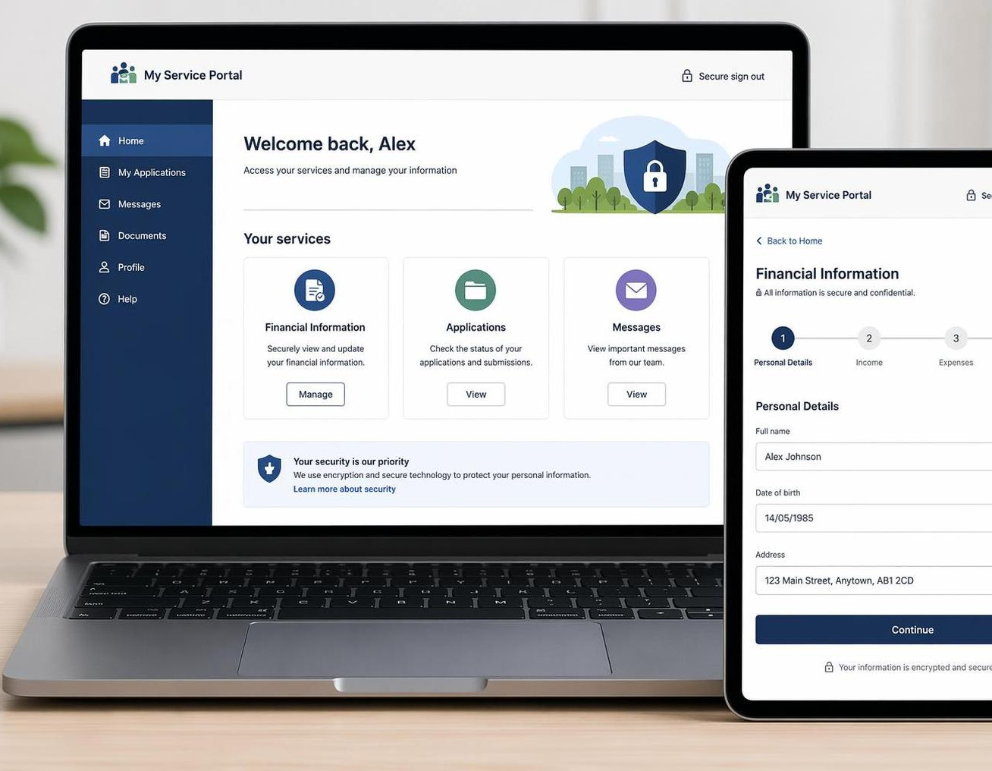
BetterCare Finance
How it helps
An online way to share financial information with the Council
Makes the process quicker allowing for decisions to be made sooner
Gives an indicative contribution amount at the end of the form, reducing outcome wait times
Notes:
BetterCare Finance is our online option that can help some people share financial information more easily, and for some families it can make things feel quicker and clearer as it gives an indicative contribution amount at the end of the form. Individuals then have the option to submit the form to ourselves to review once a package of care has been agreed by Adult Social Care. They can also share a ‘PIN’ with their social worker who can review the indicative amount also, to allow them to assist with putting a package of care in place.

Slide 10
The Teams Involved
Financial Assessments & Benefits Advice (FABA): collect financial information to assess individuals for care charges; identify any benefits our customers are entitled to; action any queries and provide advice relating to the charging guidance, policies and benefits.
Charging Team: Sends bills chase arrears, issue debt letters and resolve invoice queries
Income & Debt Recovery Team: Helps with processing payments and payment plans if debt cases
Notes:
Several teams work together through out this process, but you do not need to remember every team name.

Slide 11
Help and support
Warwickshire County Council website — Care charges and financial assessment guidance
Citizens Advice — Independent advice on money, benefits, and care costs
Age UK — Information and support for later life and care
Financial Assessments & Benefits Advice Team — Support with questions about the assessment
Adult Social Care – advice and support regarding care needs
Notes:
Here are a few places to go for more help. The council website has the local charging policy and guidance, and further information. Citizens Advice and Age UK can offer wider support on money, benefits, and care costs. Our Financial Assessments and Benefits Advice Team can also help with questions about the assessment process.

Slide 12
Questions and Thanks
Please ask any questions — we are here to help.
Notes:
Thank you for listening. I know this topic can feel complicated, especially when you are already supporting someone else day to day. Please do ask any questions, whether they are big or small.

