Slide 1


WHO IS A YOUNG CARER?

Slide 2

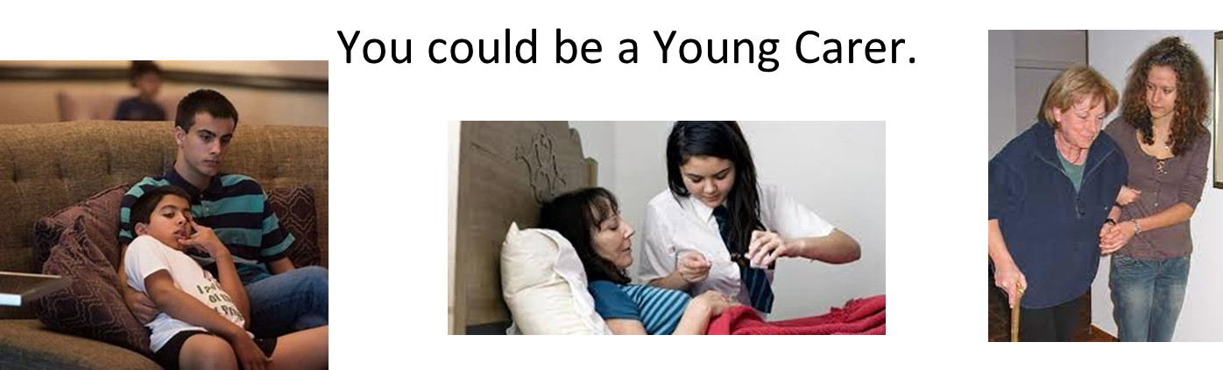
Caring Together Warwickshire
Do you look after someone in your family who can't manage without your help?
Notes:
Do you have a sibling with additional needs such as
ADHD,ASD, any learning needs?
Do you support parents in dropping them to school
Are you impacted by their needs behaviours?

Slide 3


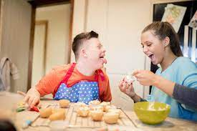
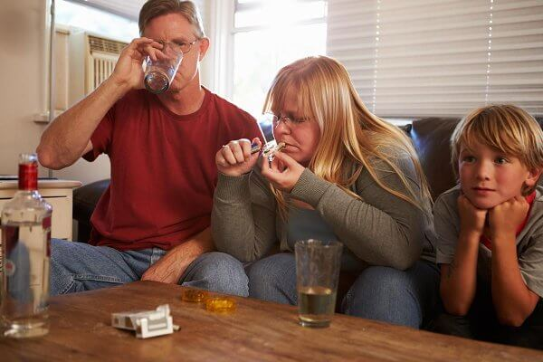
Caring Together Warwickshire
Young Carers are children and young people aged 5 - 18 who help look after someone in their family. This could be your mum, dad, brother, sister, grandparent, friend or neighbour and they don't have to live with you.
They could have a:
Disability
Long Term Illness
Poor Mental Health
Addiction to drugs and/or alcohol misuse

Slide 4
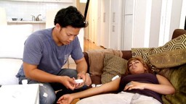
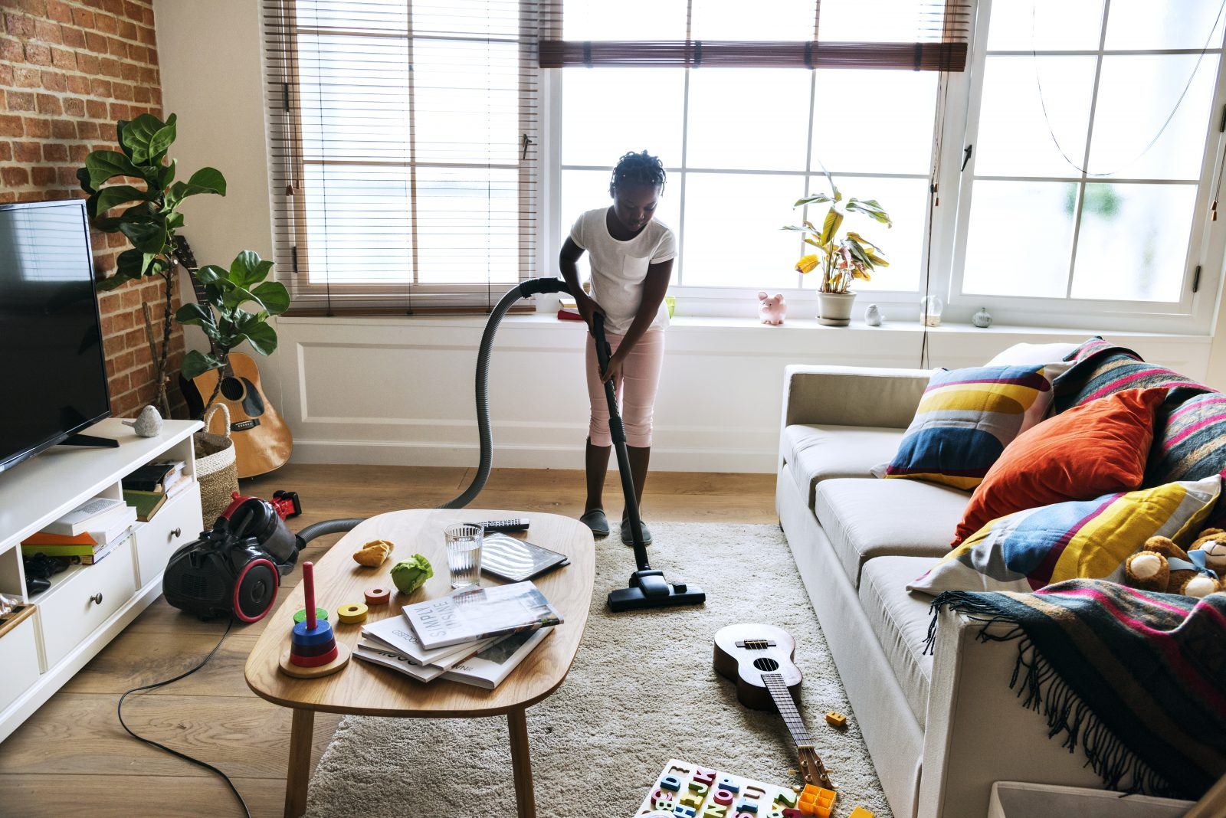
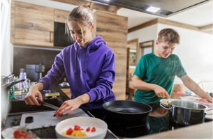
Caring Together Warwickshire
Many young carers don't think of themselves as a carer, the caring role often grows over time.
Some of the tasks young carers take on include:
Tidying the house
Shopping
Helping wash and dress the person they're caring for
Administering medicines
Providing emotional support
Looking after a younger brother or sister
Cooking meals
Washing the dishes
Helping with bills and money / collecting benefits
That’s tough for most adults – no child should have to shoulder such responsibilities alone.

Slide 5

Caring Together Warwickshire
There are likely to be young carers in every school​
There are about 700,000 young carers in the UK
There are many we do not know about, these are called ‘Hidden Young Carers’ ​
In Coventry, there are approximately around 5,000 Young Carers – that we are aware of!

Slide 6


Caring Together Warwickshire
How to help?

Slide 7




THANK YOU
Please follow us for updates on
caringtogetheryoungcarerswarks
Caring Together Warwickshire Young Carers

