Slide 1



Who is a Young Carer?

Slide 2

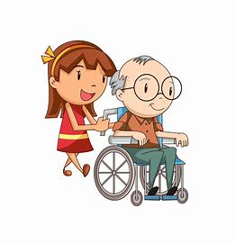
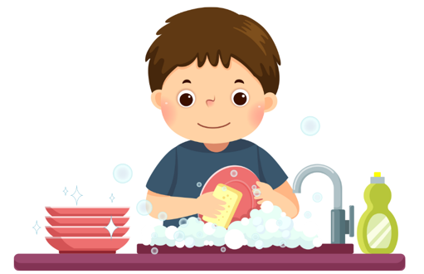
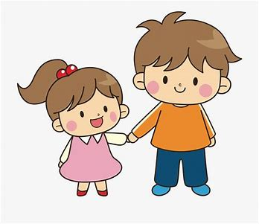
Caring Together Warwickshire
Do you look after someone in your family who can't manage without
your help?
You could be a Young Carer.
Notes:
Do you have a sibling with additional needs such as
ADHD,ASD, any learning needs?
Do you support parents in dropping them to school
Are you impacted by their needs behaviours?

Slide 3
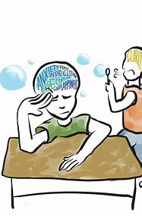
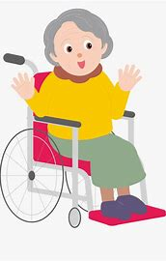

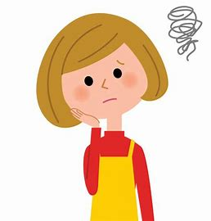
Caring Together Warwickshire
Young Carers are children and young people aged 5 - 18 who help look after someone in their family.
They could have a:
Disability
Long-term health condition
Poor mental health
Addition to drugs and or alcohol misuse
This could be your mum, dad, brother, sister, grandparent, friend or neighbour and they don't have to live with you.

Slide 4
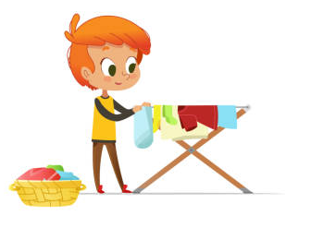
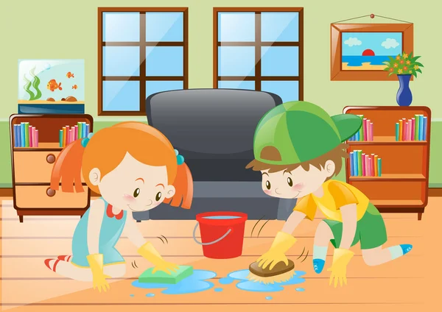
Caring Together Warwickshire
Many young carers don't think of themselves as a carer, the caring role often grows over time.
Some of the tasks young carers take on include:
Shopping
Jobs around the house
Helping with medicines
Looking after a brother or sister
Providing emotional support
Helping with bills and money or collecting benefits – no child should have to shoulder such responsibilities alone.

Slide 5

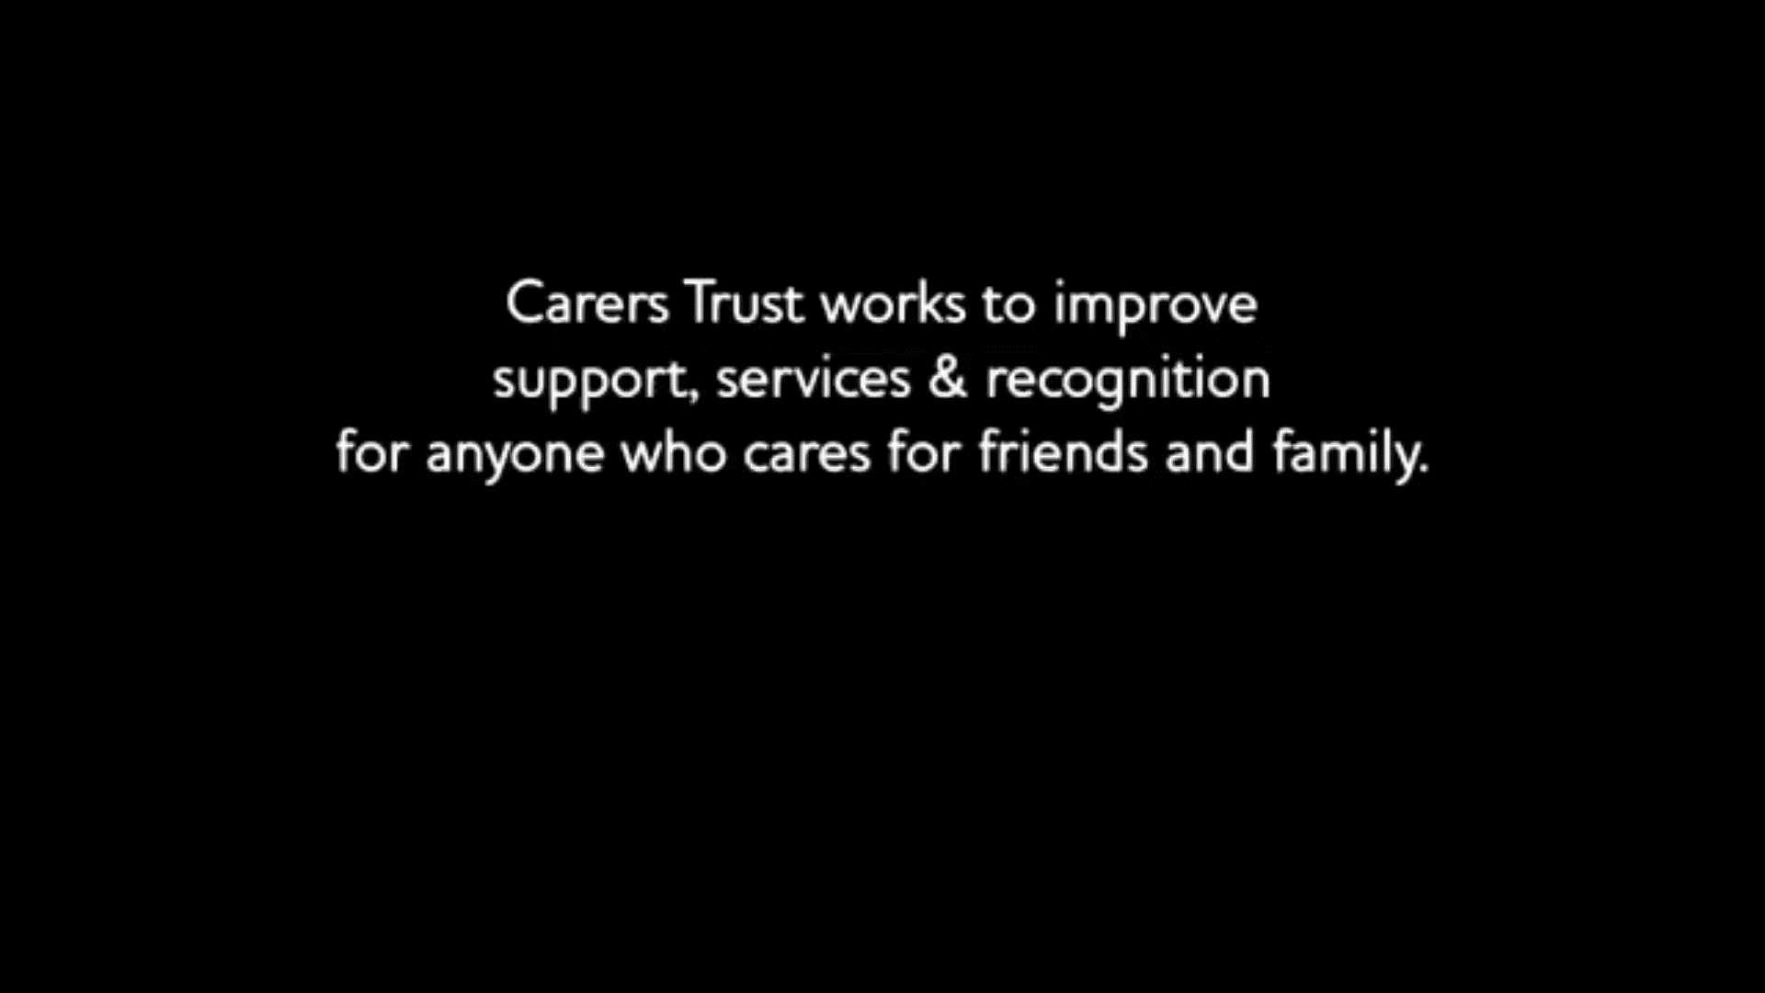
Caring Together Warwickshire
Notes:
Video provided by NHS England ‘Out of the woods’

Slide 6

Caring Together Warwickshire
Did You Know?
There are
likely to be
young carers
in every school​
There are about 700,000 young carers in the UK
There are many we do not know about, these are called ‘Hidden Young Carers’ ​
In Coventry, there are approximately around 5,000 Young Carers – that we are aware of!

Slide 7


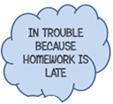
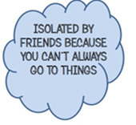
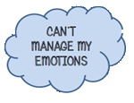
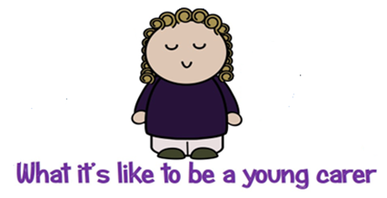


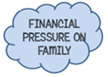
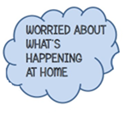
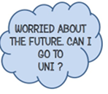

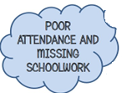
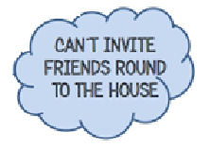
Caring Together Warwickshire
Notes:
Lack of attendance to school
- regularly late to school
Do they leave school early to support a family member or sibling?
Unkept appearance due to not having time to get ready in the morning
Do they have a caring nature e.g are they always asking after everyone?
Do they struggle to complete their homework and meet deadlines on time?
Not being able to socialize with peers / do they often decline invitations out?
Do they appear tired most of the time?
Do they appear anxious, stressed or overwhelmed?

Slide 8
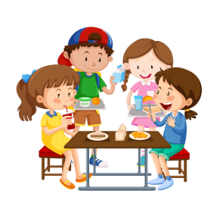

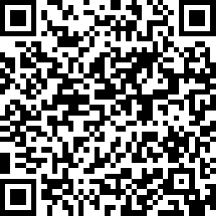


Caring Together Warwickshire
How to help?
Speak to the person you’re worried about
Ask them if you can help in contacting us
Speak to a teacher / encourage a young carer to talk to staff

Slide 9





THANK YOU
Please follow us for updates on
caringtogetheryoungcarerswarks
Caring Together Warwickshire Young Carers

