Slide 1




Welcome To Carers Trust, Young Carers Networking Event
Notes:
Thank you for joining our first Young Carers Networking event, which we plan to deliver every term, with updates on the YCiS award, whats new in policies, and what is happening nationally and locally for young carers.

Slide 2
What is a YCiS Award?
A free initiative that makes it as easy as possible for schools to support young carers, and awards good practice.
Run jointly by Carers Trust National and The Children’s Society, the Young Carers in Schools (YCiS) programme works with schools across England to share good practice, provide relevant tools and training, and celebrates the great outcomes many schools achieve for young carers.

Slide 3
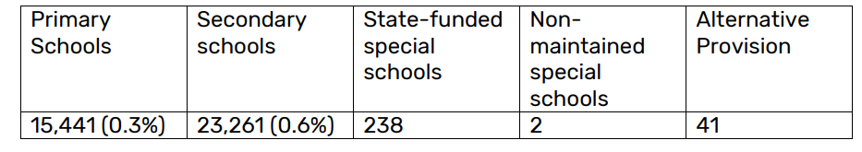
Did you know?
Schools are now responsible for submitting data regarding how many young carers they have within their setting. The first year of school census data relating to young carers was released in June 2023 on the Department for Education website.
The data showed that there was significant under-reporting of the number of young carers in schools (both when compared to the estimated number of young carers in schools, and the numbers known to local young carer services).
The Department for Education stated that 79% of schools recorded having no young carers. We know this is not a true representation of how many young carers are currently in education.
Notes:
We know that there at 2 YC's in every class, in every school

Slide 4
Did you Know?
Carers Trust’s latest report into the experiences of young carers and young adult carers, ‘Being a young carer is not a choice; it’s just what we do’ found that 1 in 3 young carers and young adult carers said they struggle to balance caring with education.
A cross-European study of young carers also found that 37% of young carers said their performance had suffered as a result of caring responsibilities, and 36% reported being bullied specifically about caring.

Slide 5
Why take part?
The Young Carers in Schools programme enables schools to:
Gain national recognition for raising outcomes for young carers through the Young Carers in Schools Award.
Identify manageable steps to improve educational outcomes for this vulnerable pupil group – the programme breaks down the actions schools can take so that your school can easily prioritise what to do next. ( 5 Pillars)
Access additional support including tools, templates, good practice examples, and local support from our Young Carers Team.
Most importantly – Help to support these vulnerable young people who face significant challenges as part of their caring role

Slide 6
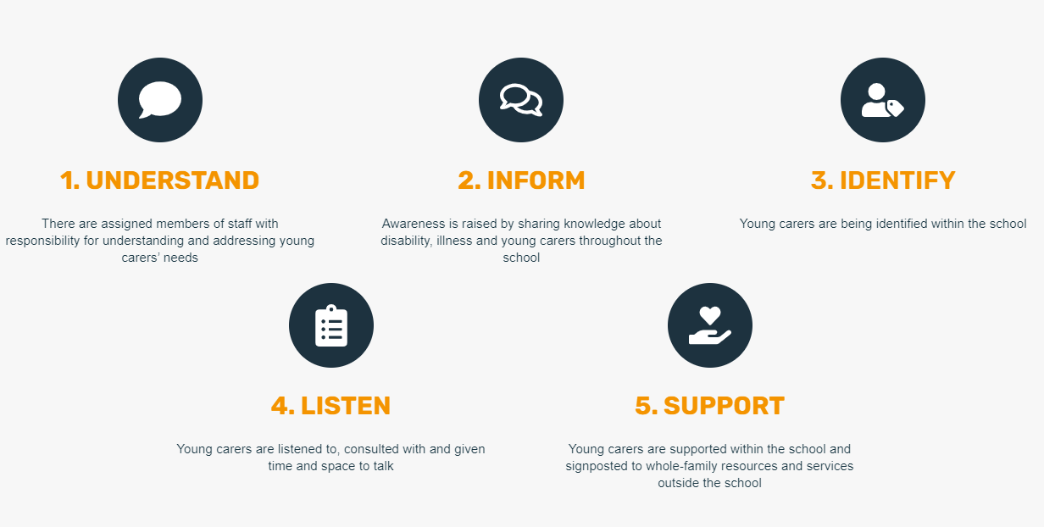
The 5 Standards of YCiS Programme
Notes:
Understand:
Having is designated Young Carer Lead act as a main contact for YCs and families is crucial. These staff members have a responsibility for understanding and addressing young carers needs. There is also Carer Aware training available that should be delivered to all staff as part of young carer training, this ensures all staff have an understanding of what needs a young carer might have.
Inform:
It is important that schools have a written young carers policy checklist/ agreement so that all staff are informed. Once a school has signed up they will have access to tools and examples for best practice should you want to write your own policy for your school.
Example Link – add to chat
https://view.officeapps.live.com/op/view.aspx?src=https%3A%2F%2Fyoungcarersinschools.com%2Fwp-content%2Fuploads%2F2023%2F12%2Fexamples-of-young-carer-policies-and-models-of-support.docx&wdOrigin=BROWSELINK
Whether you are using CPOMS, SIMS or any other monitoring system, your school should flag young carers as part of your records. This is vital as we all know that young carers are under-identified in school settings. The 2023 Census shows us that 70% of schools recorded not having any young carers but we know that there are at lease 2 young carers in every classroom in every school.
Identify
Young Carers are informing us that their most important priorities are focused on early identification and receiving the appropriate support in school. In order to achieve this, a whole-school approach where young carers can be identified as early as possible is needed and it is vital that schools raise awareness of young carers regularly through school assemblies, discussed in PSHE lessons, young carers being mentioned in newsletters, a easily accessible noticeboard is displayed and fundraising. Lunch Time drop in sessions for pupils who may think they are a young carer or have young carer questions can attend and meet a schools young carer lead and have all there questions answered. Schools should also raise awareness of young cares with their governing body and this could be a letter sent to them explaining the definition of a young carer, potential responsibilities they may have and tasks they may face in education.
Listen
Young Carers need a voice and to be heard in schools. A Young Carer Suggestion Box is a great way of getting feedback and also ideas of how to support our young carers as young carers may not all feel comfortable enough to approach the leads and may prefer to do this anonymously. Young Carers should be openly discussed and embraced in all schools to take away stigmas and to help young cares feel more inclusive and listened to.
Support
Every school should be providing young carer specific support like homework support, making sure young carers have the opportunity to complete homework at lunch times if they wish to. Many young carers do not have the time or space to do this at home due to their caring responsibilities. Some Young Carers need to contact their cared fors during school hours so understanding this and allowing time to touch base at home is a great way of a school showing how they support young carers. Working with linked schools around transition to ensure information is shared regarding their caring role. Additionally to what schools can offer within their setting, signposting to Young Carers for their statutory young carers assessment with the families consent, young carers services can then support the young carer and their family outside of the school remit.

Slide 7

How To Apply
Please register all interest to sign up for the YCiS Award via email to youngcarers@carerstrusthofe.org.uk and a member of our team will send you a form to complete the registration.
We will then send you the three packs below:
Young Carers in Schools Award Pack
YCiS Award Provision Map
YCiS Award Evidence Example Pack
Notes:
Young Carers in Schools Award Pack: A full guide to support schools to implement and evidence a Young Carers in Schools award. Contains a step by step guide to the process and a comprehensive checklist of required evidence.
YCiS Award Provision Map: This is a table that outlines the criteria of the Award, the suggested evidence and helps to track progress towards the Award
YCiS Award Evidence Example Pack: This document provides examples of evidence that can be supplied.

Slide 8
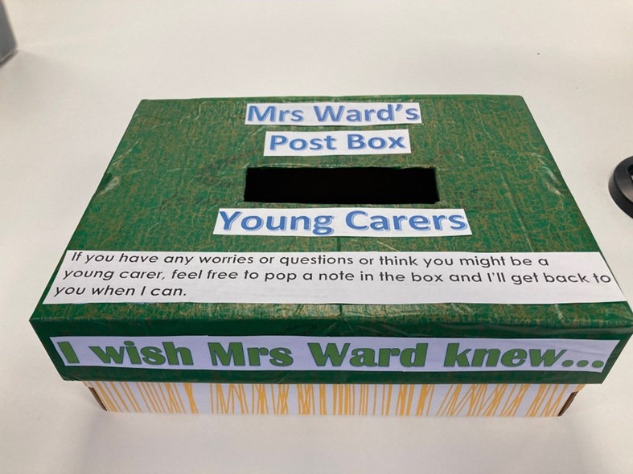

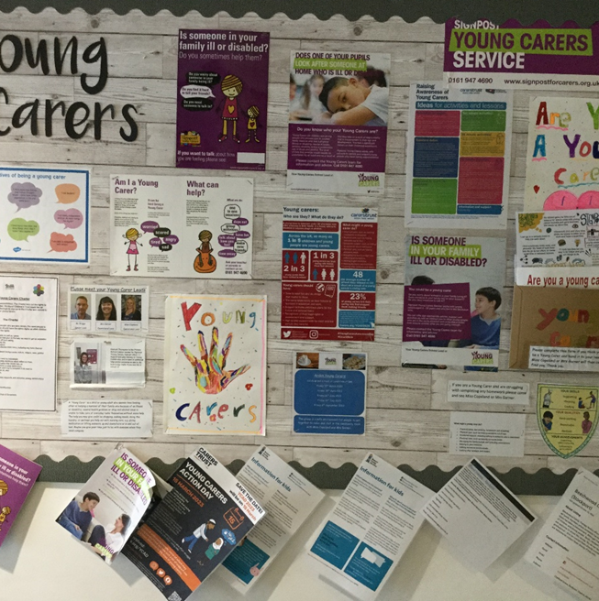
How To Submit
  Evidence must be submitted on 28th March, June, September and December.
  The Childrens Society and Carers Trust will Within 7 days — we will confirm receipt of your application.
  Within 4-6 weeks of the submission deadline — applications will be reviewed by two independent verifiers and an internal multi-agency panel is held to discuss each application.
  Within 2 weeks of the panel — schools will be contacted with the outcome of their application.
Notes:
To achieve the Young Carers in Schools Award, evidence must be provided to show how your school or college is implementing the criteria.
A lot of the evidence required to show the work you are doing to identify and support young carers can be provided through photos of your young carers noticeboard for pupils. You could send us both a wide-angle picture of the noticeboard, but also a close-up picture of the specific area for each relevant section of the Award. It is important you upload clear photos and label them appropriately.

Slide 9
What Next...
Once awarded, the award in valid for 3 years after which time you will need to re-submit your evidence.
Continued support from Local Young Carers Service
There is also a Young Carers in Schools Award Plus – further details are in the Award Plus pack guidance which will be launched in Spring 2024.
Some schools have previously registered for the YCiS Award, when it was a tiered program of Bronze, Silver & Gold. Schools will simply re-submit their evidence.
Notes:
Even if you are confident in your provision for young carers, we ask that all schools initially apply for the Young Carers in Schools Award – this will make the process easier if you wish to apply for the Young Carers in Schools Award Plus.
The Award will have a three-year expiry date to ensure that the provision for young carers remains in place. Schools will be contacted and asked to re-apply.
Schools will also be asked how many young carers they have recorded when they submit their application. We will be in contact a year after the school achieves the Award to see if the number of identified young carers has increased.

Slide 10


Local News
Young Carers Groups
Young Carers Action Day- March 13th- Non-Uniform Day
#FairerFuturesForYoungCarers #YoungCarersActionDay

Slide 11
Any Questions?
Young Carers Manager- Jodie Cotterrell
Young Carers Outreach & Activity Co-Ordinator- Kelly Butler
Young Carers YCiS & Assessment Officer- Jamie Jiminez
Young Carers Assessment Officer Warwickshire- Hayley Wheatley
Young Carers Assessment Officer Warwickshire- Matt Deakin youngcarers@carerstrusthofe.org.uk

